Slide 1
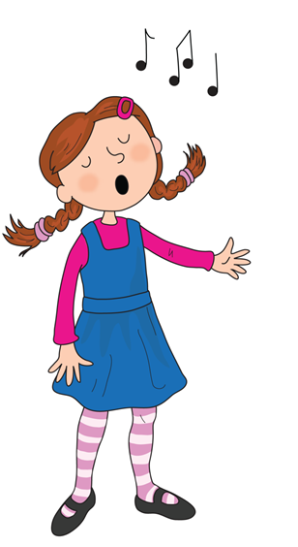
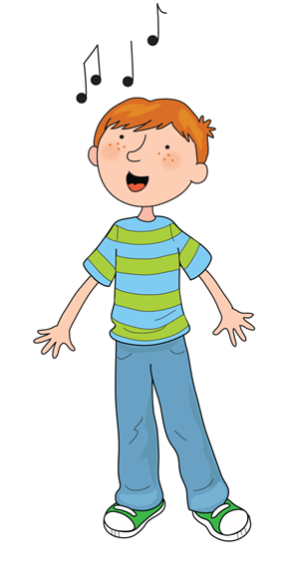
Song of Sounds

Slide 2
Song of Sounds

Slide 3
We can sing a song of sounds, skip to my lou my darling

Slide 4
Ants on an apple a a a

Slide 5
Butterflies are beautiful b b b

Slide 6
Caterpillars coughing c c c

Slide 7
Skip to my lou my darling

Slide 8
Dinosaurs are dancing d d d

Slide 9
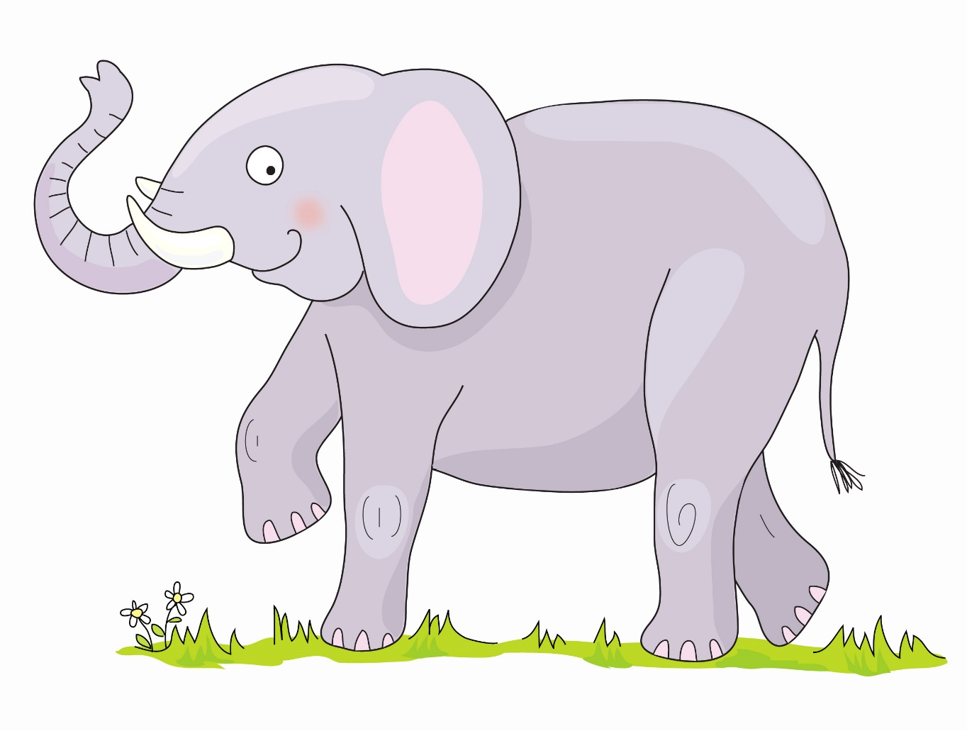
Elephant’s enormous e e e

Slide 10
Fish are funny f f f

Slide 11
Skip to my lou my darling

Slide 12
Goats are gardening g g g

Slide 13
Hats on heads h h h

Slide 14
Insects are interesting i i i

Slide 15
Skip to my lou my darling

Slide 16
Jellybeans are jumping j j j

Slide 17
Kings flying kites k k k

Slide 18
Lions love lollipops l l l

Slide 19
Skip to my lou my darling

Slide 20
Mice are munching m m m

Slide 21
Nurse Nelly’s nice n n n

Slide 22
Octopus is orange o o o

Slide 23
Skip to my lou my darling

Slide 24
Popcorn popping p p p

Slide 25
Queens run quickly qu qu qu

Slide 26
Rabbits are rascals r r r

Slide 27
Skip to my lou my darling

Slide 28
Sausages are sizzling s s s

Slide 29
Tiger on the TV t t t

Slide 30
Umbrellas up u u u

Slide 31
Skip to my lou my darling

Slide 32
Val has a violin v v v

Slide 33
Whales in the water w w w

Slide 34
Fox on a box x x x

Slide 35
Skip to my lou my darling

Slide 36
Yellow yoyo y y y

Slide 37
Zebras in the zoo z z z

Slide 38
Sing a song ng ng ng

Slide 39
Skip to my lou my darling

Slide 40
Sharks on the shore sh sh sh

Slide 41
Chickens eating cheese ch ch ch

Slide 42
Thorn in my thumb th th th

Slide 43
Skip to my lou my darling

Slide 44
Train in the rain ai ai ai

Slide 45
Busy busy bee ee ee ee

Slide 46
Soar up high igh igh igh

Slide 47
Skip to my lou my darling

Slide 48
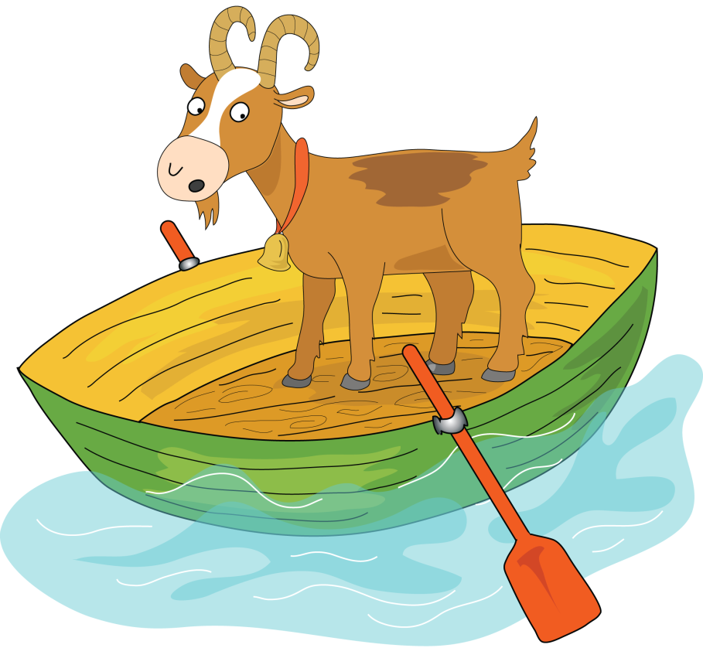
Goat on a boat oa oa oa

Slide 49
Zoom to the moon oo oo oo

Slide 50
Look in a book oo oo oo

Slide 51
Skip to my lou my darling

Slide 52
Go far in your car ar ar ar

Slide 53
It’s a horse of course or or or

Slide 54
Flower in a shower er er er

Slide 55
Skip to my lou my darling

Slide 56
Don’t be noisy oi oi oi

Slide 57
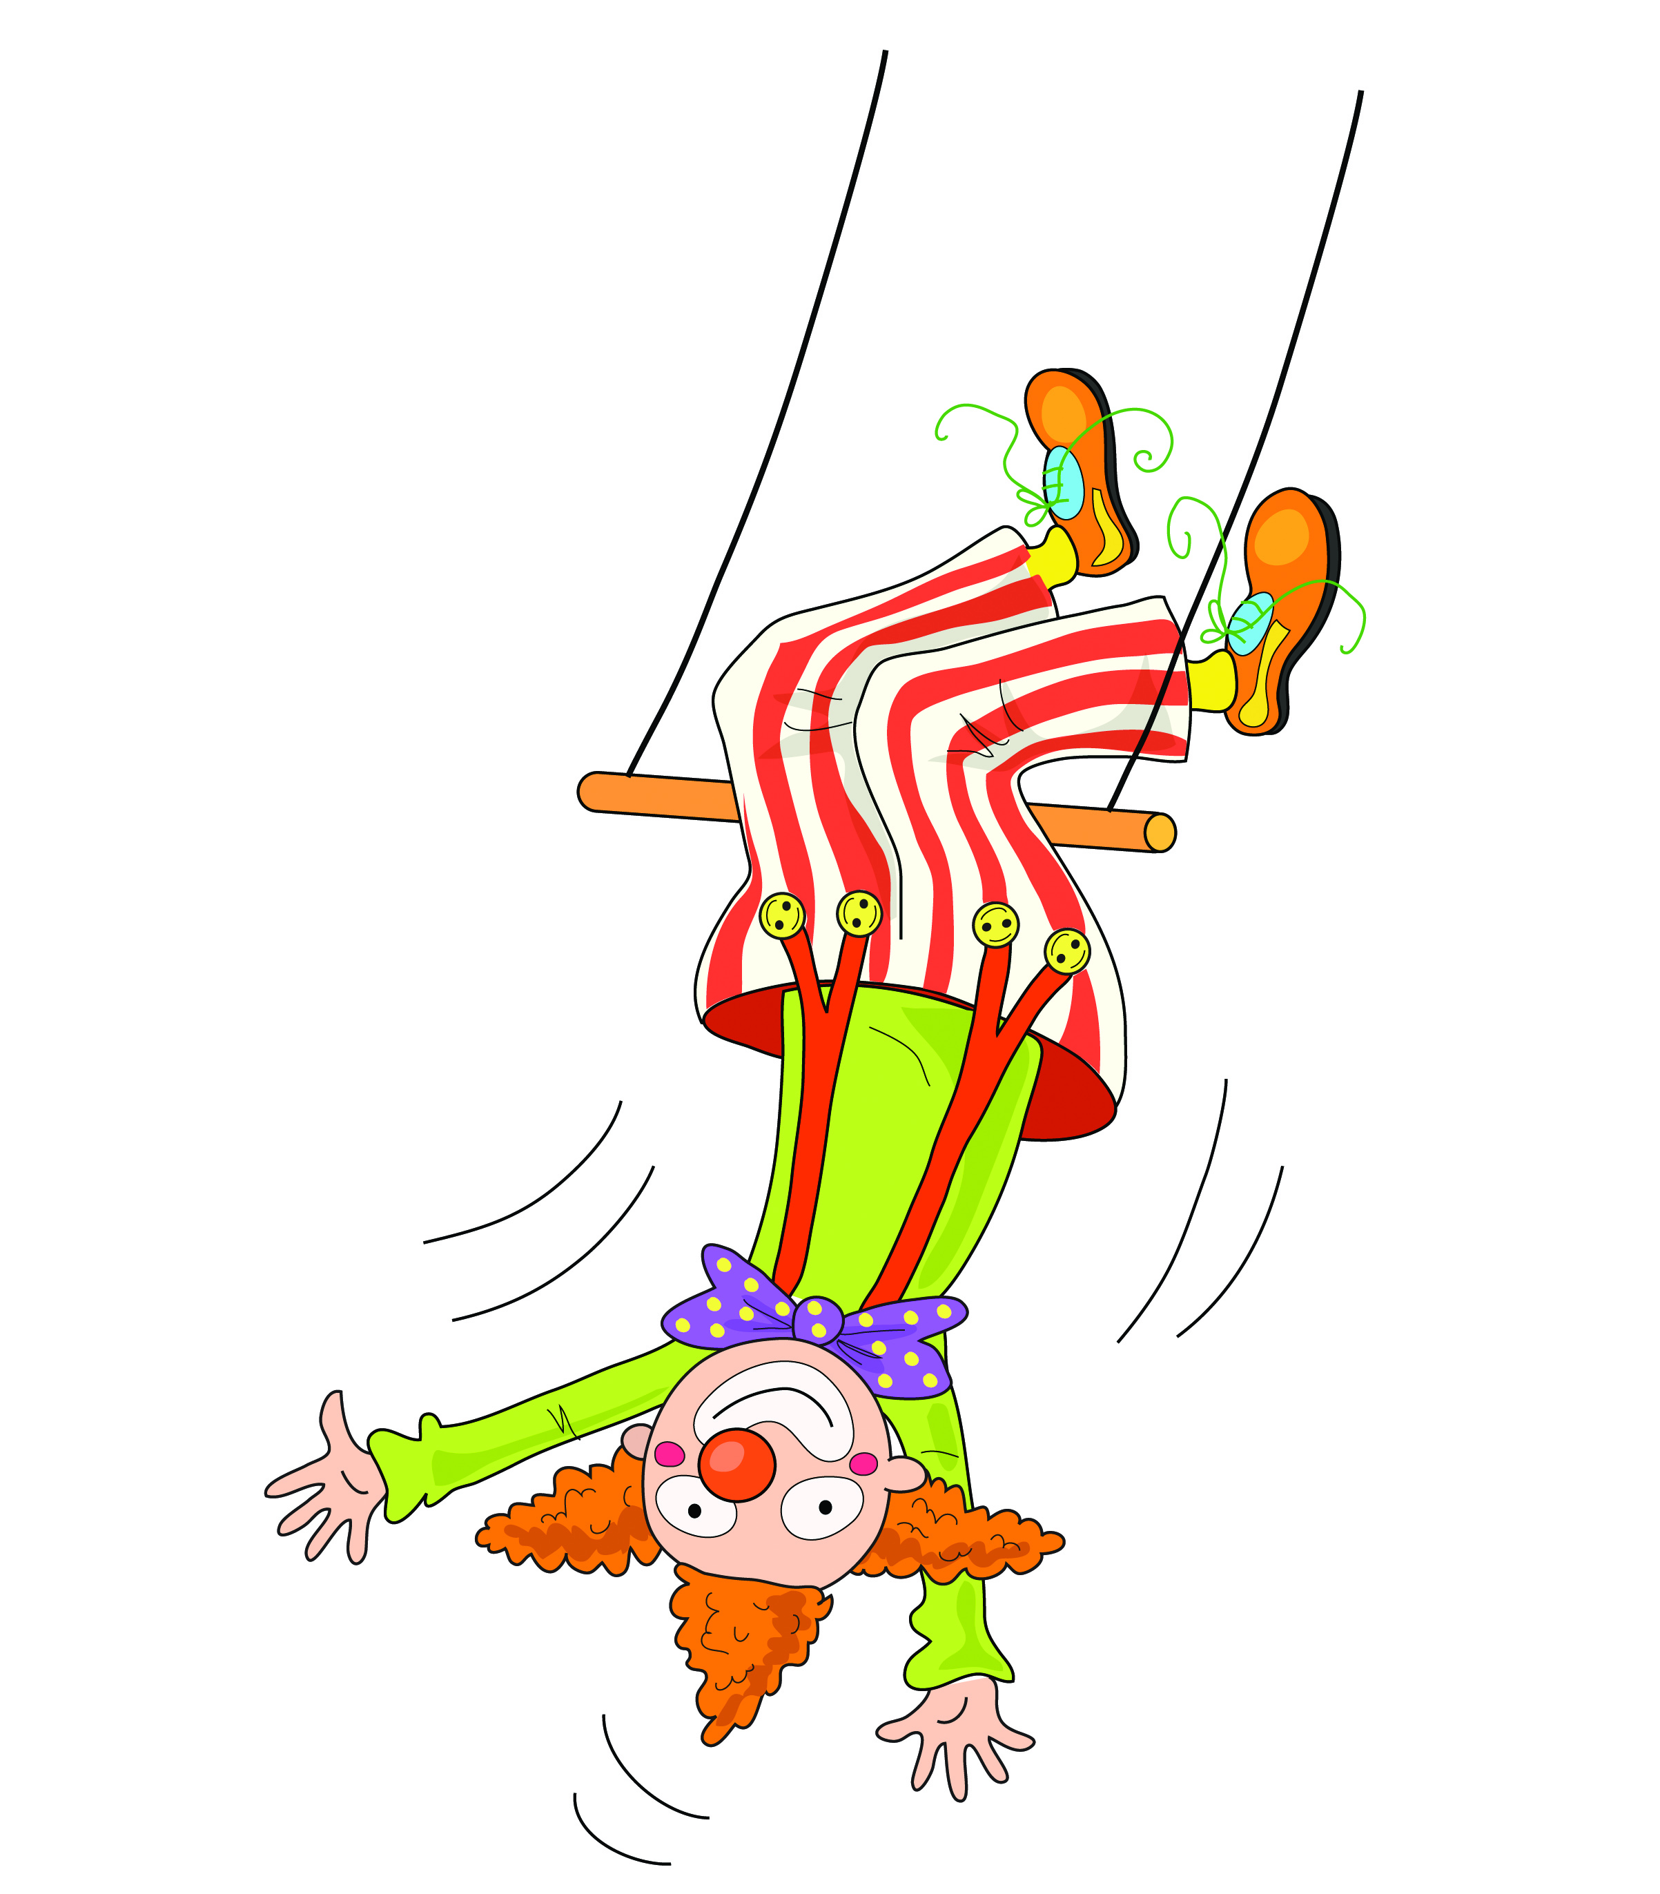
Clown upside down ow ow ow

Slide 58
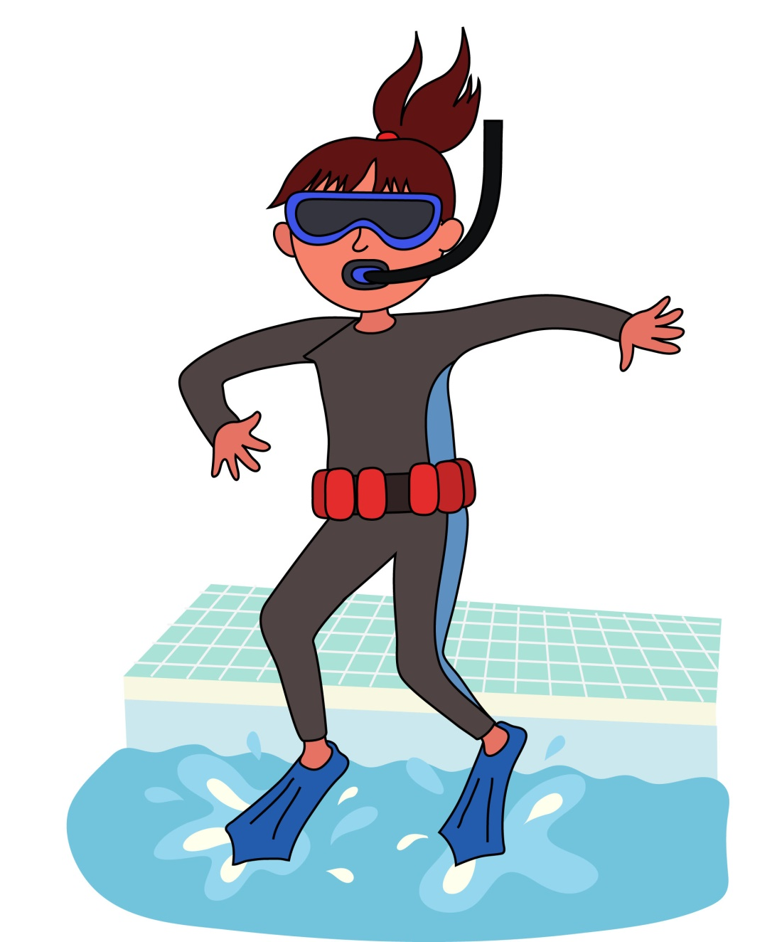
I think I will sink nk nk nk

Slide 59
Skip to my lou my darling

Slide 60
Hairy fairy air air air

Slide 61
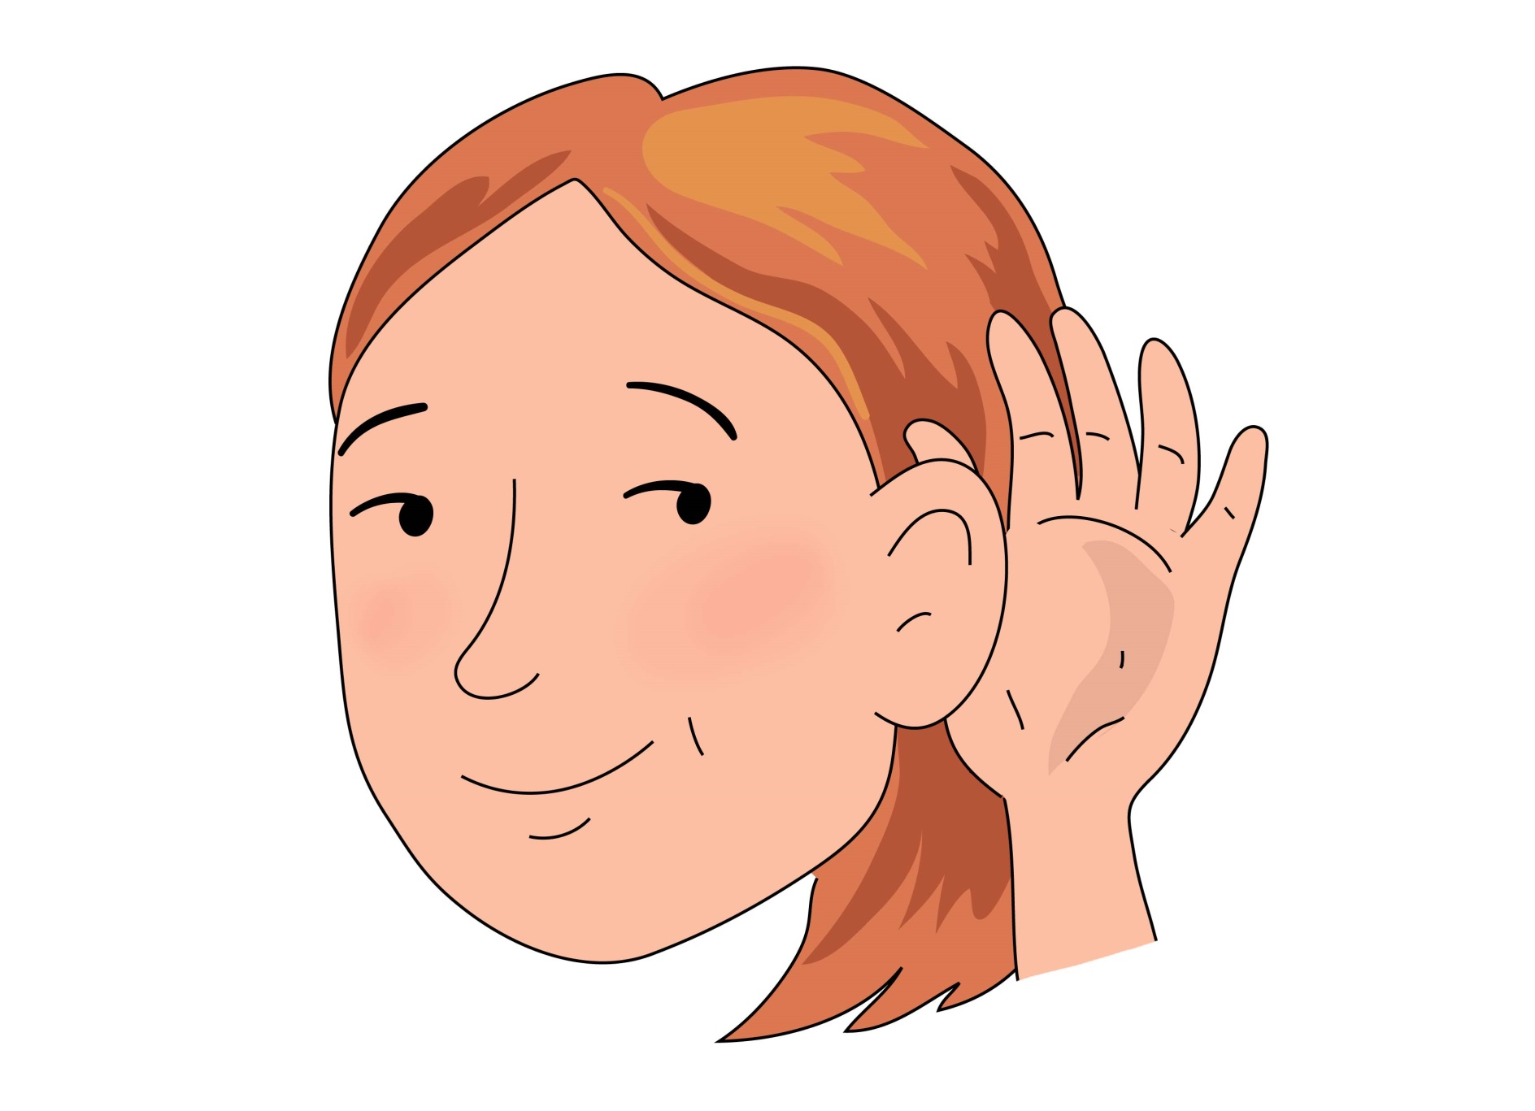
Hear with your ear
ear ear ear

Slide 62
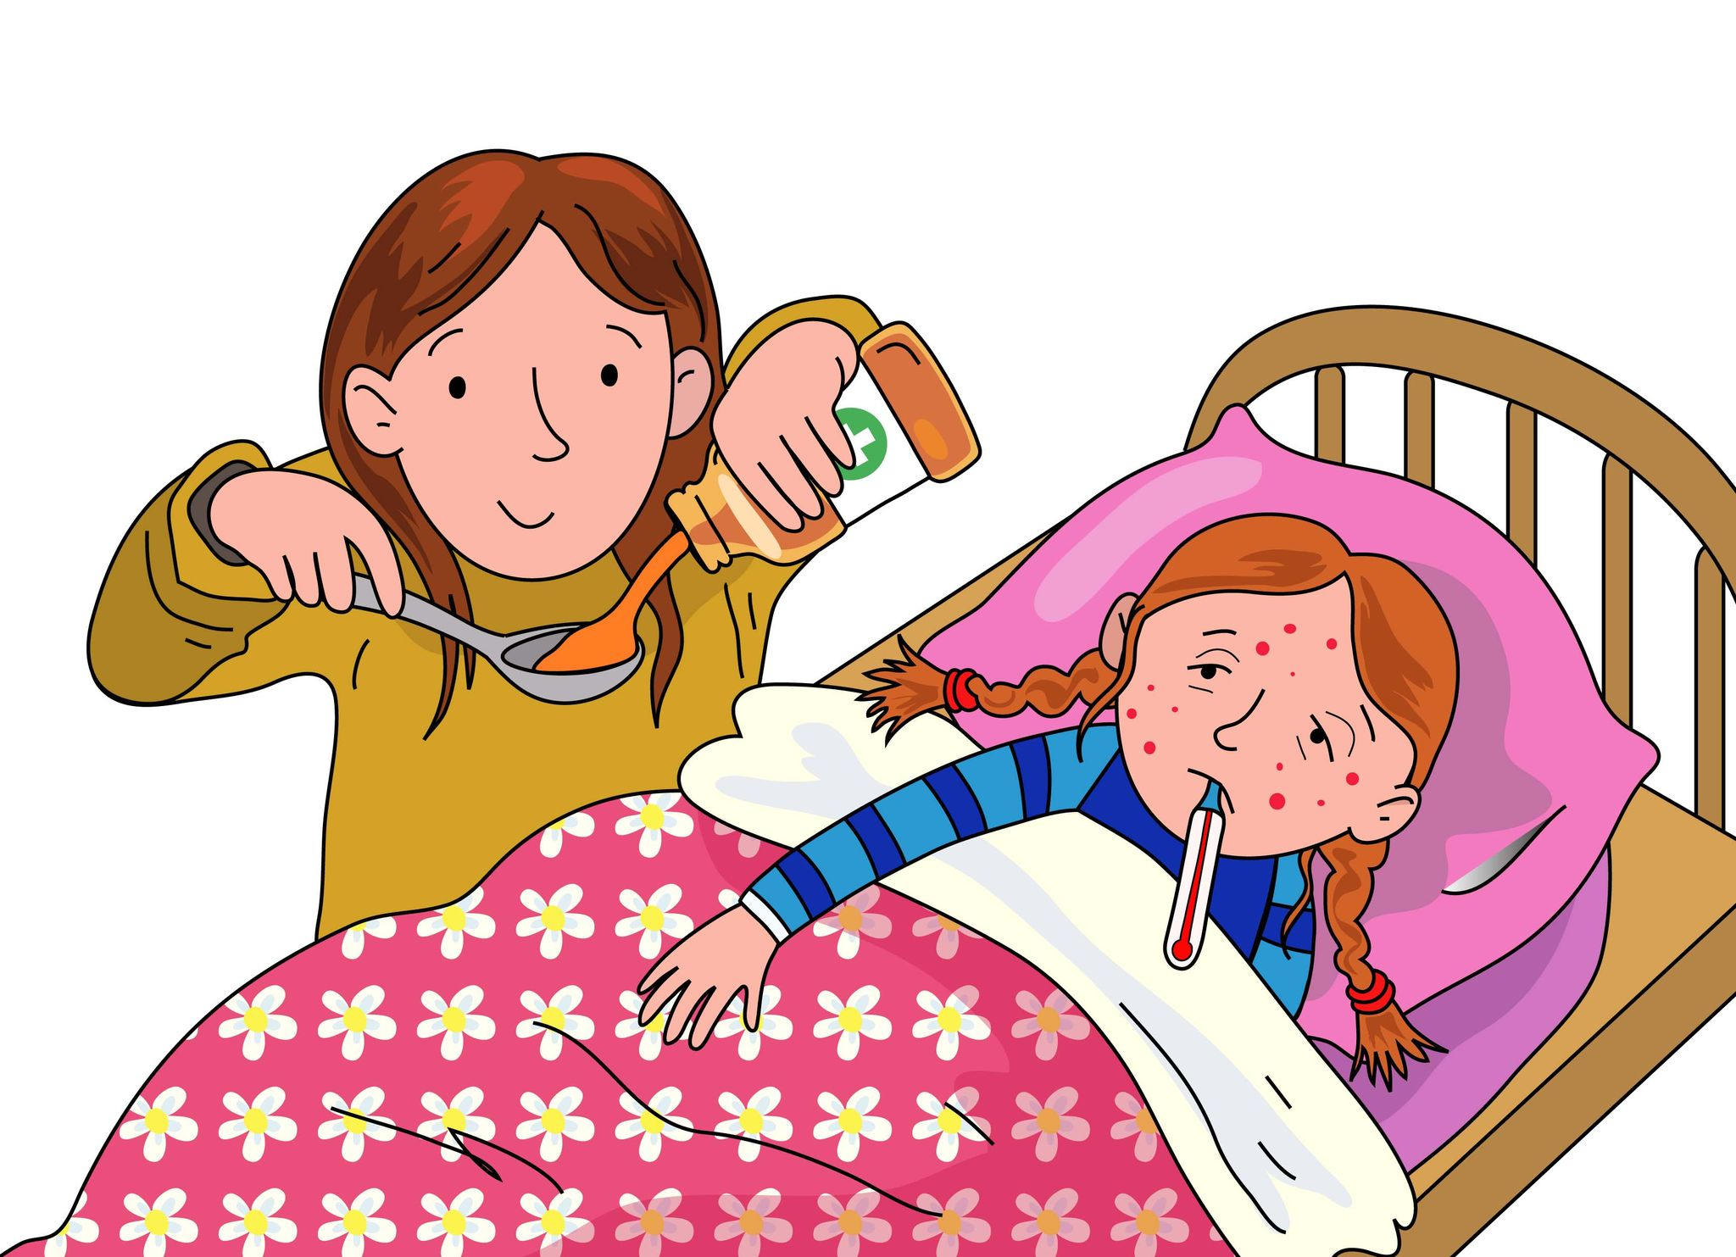
I’m sure there’s a cure ure ure ure

Slide 63
Skip to my lou my darling

Slide 64
Now we’ve sung our song to you, you can learn to blend sounds too.

Slide 65
Blending helps you read and write so sing this song all day and night.

